Slide 1
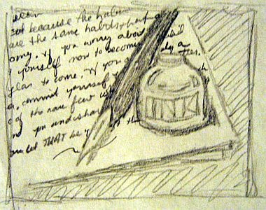
Example Essay
Illustrates and demonstrates

Slide 2
What is an Example Essay?
Helps illustrate a point to prove
Ex. San Francisco is a multi-cultural city
China town, North Beach, the Mission
Ex. Tom Hanks can play many and varied roles
Forest Gump, Big, Cast Away
Ex. I have dated many losers.
Matt, Tom, and Bob

Slide 3
When will we use in Life?
In what ways might giving examples be good in our everyday experience – work, family, friends, etc?

Slide 4
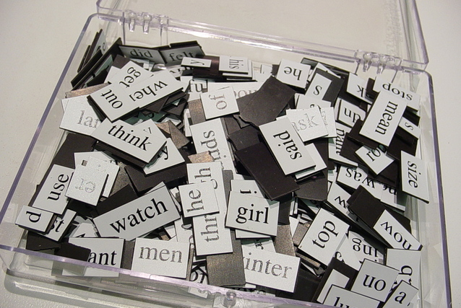
“What’s in a Word” by Sharon Begley

Slide 5
Read as a Writer 1. Thesis: What is the thesis? Is it clear? 2. Support: How many examples does Begley use to support the thesis? How effective are they? 3. Organization: Find the introductory and concluding paragraphs. What strategies do they use?
Read for Ideas:
4. Examine your own language compared to another language you have learned. What are some examples that may show that language shapes our thoughts?
5. Examine differences within the same language? Do men and women, young and old, or Californians and Texans respond to the same word differently? Give examples.

Slide 6
Purpose: Inform
1. Inform: Examples can help clarify abstract or complex ideas
ex. Students should not use slang in their essays. Bitchin’, Dude, Gnarly, Mean Mug, Totes McGotes

Slide 7
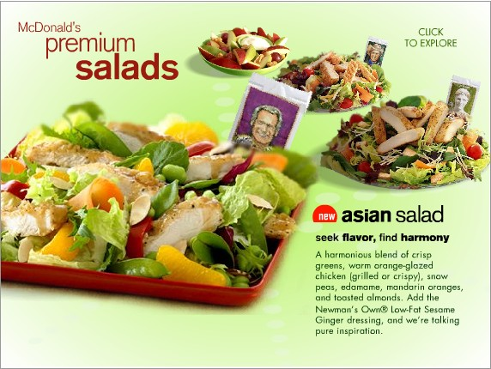
Purpose: Persuade
2. Persuade: Convince reader to accept argument
ex. McDonald’s is and economical and healthy choice for students.
dollar menu, salads, kids meals

Slide 8
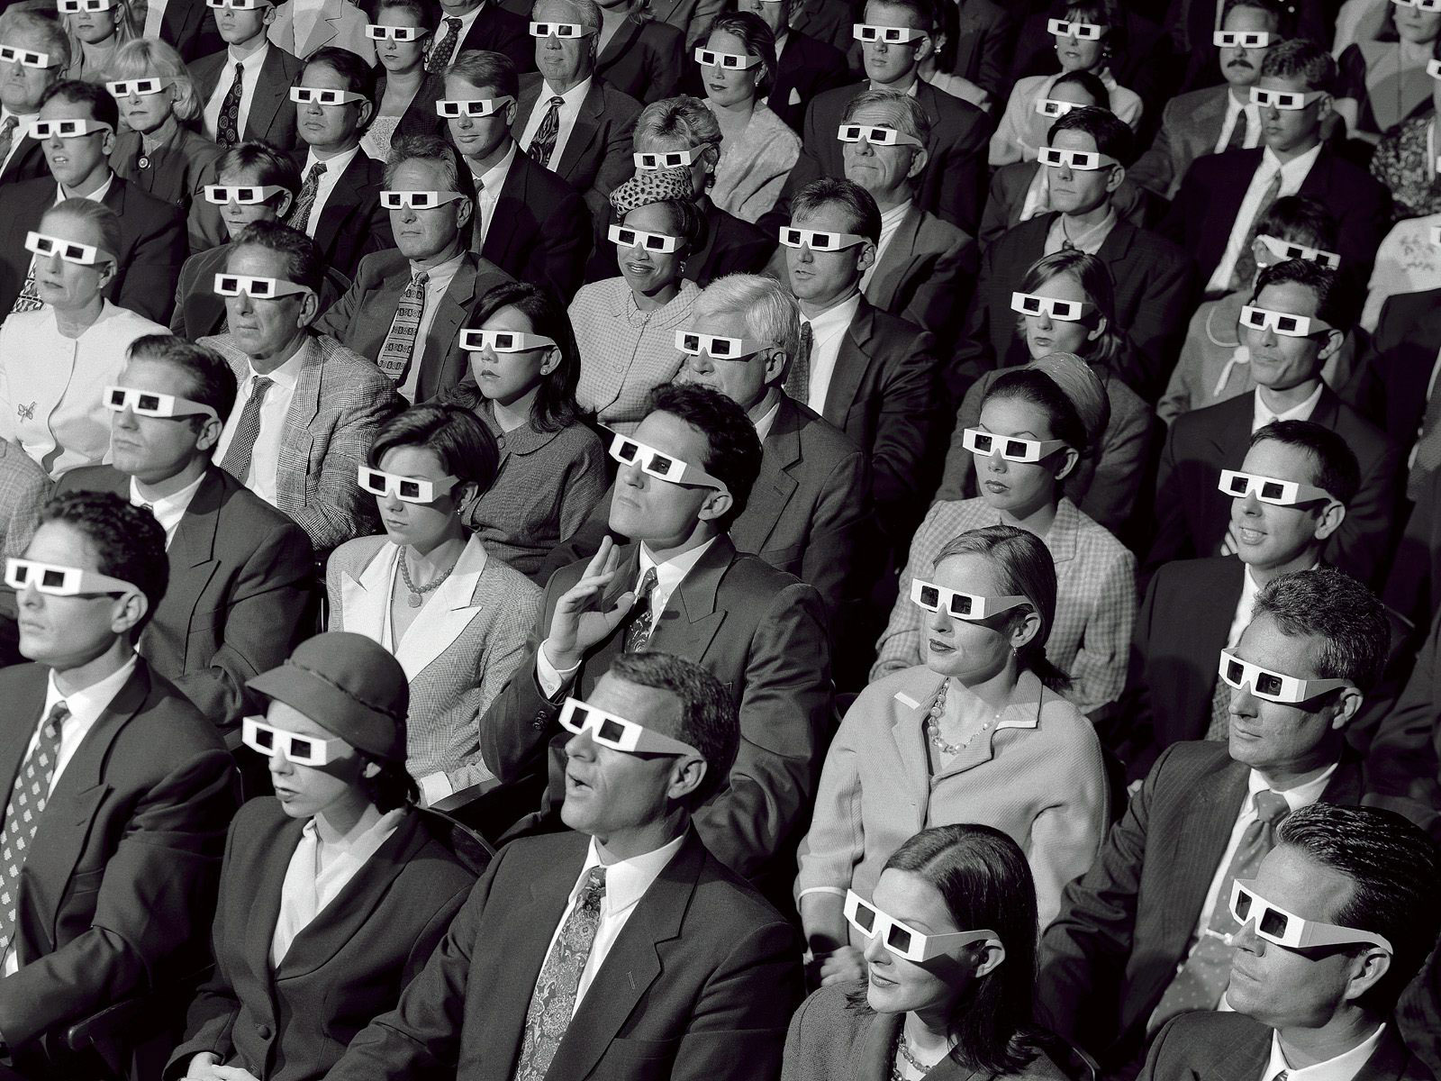
Audience
Remember to think about who your audience is when choosing examples.
Activity: Divide class into 3 groups. Each group is going to argue why one should go to Disneyland using examples. But each group will have a different audience. We’ll try to guess the audience.

Slide 9
Extended and Listed
1. Extended: Gives one long example
good: Lots of great detail and drama
bad: May not persuade the reader with just one.
2. Listed (also called Enumerated): Uses many examples
good: Persuades more easily.
bad: Too brief to fully explain, can sound like laundry list

Slide 10
Practice
Page 232 in the Sundance Writer, for each statment, list 3 examples that could be developed into 3 separate paragraphs.

Slide 11
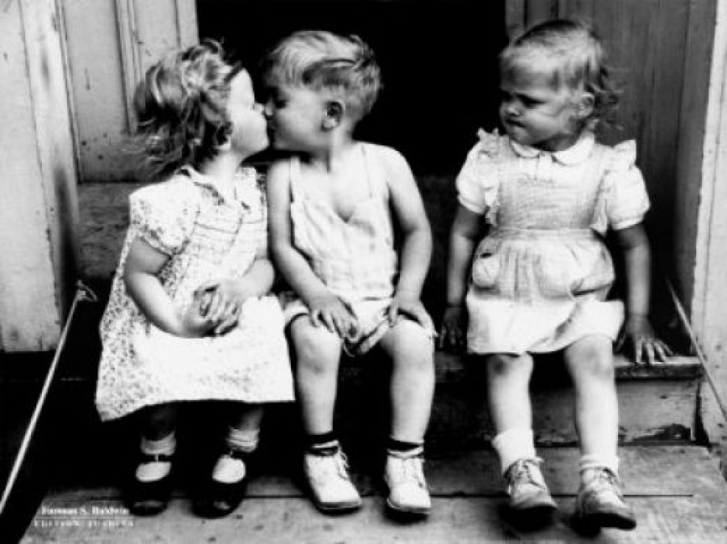
Hypothetical vs. Factual
1) Hypothetical: Fictitious, used for objectivity or future events with no real situations yet.
ex. Never date your friend’s ex.
Friend could feel betrayed
You could get jealous if they are together
Awkward comparisons

Slide 12
Factual
Factual: Based on a real incident with personal stories
Ex: Never get involved with a friend’s ex.
My friend Jane started dating her best friend, Nancy’s, ex-boyfriend, George, only 3 weeks after they had broken up, and Nancy was really angry. She yelled at Jane for 2 hours, then wrote her nasty e-mails and texts, and told the George all the bad things about Jane. Then whenever Jane would see the George and Nancy together, she worried about his infidelity. And George would often talk about Nancy when they are on dates. In the end, George and Jane broke up and Nancy and Jane are no longer friends.

Slide 13
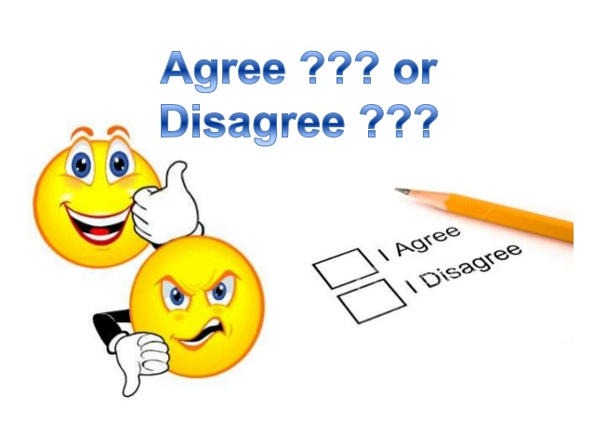
Practice
Agree/Disagree Game
I’ll give a thesis statement then everyone must go to the side of the room that shows if he/she agrees, disagrees, or has not decided.
Once you have choses your position, give examples to support your stance.

Slide 14
Dogs are better than Cats

Slide 15
TV is a mind wasting activity

Slide 16
Trump should not be president

Slide 17
De Anza has a fair registration process.

