Slide 1
AB 705 Reading & English Collaboration
Presentation by Kristin Skager

Slide 2
July, 2018 Assembly Bill AB 705 Implementation
High School Performance Metric for English
HS GPA ≥ 2.6: Transfer-Level English Composition (No additional academic or concurrent support required)
HS GPA 1.9 - 2.6: Transfer-Level English Composition + Additional academic and concurrent support recommended
HSGPA < 1.9: Transfer-Level English Composition + Additional academic and concurrent support strongly recommended

Slide 3
Seriously?

Slide 4
Impact on Developmental Reading & Writing
Loss of reading and basic skills writing instruction. No more required pre-requisite reading and writing classes!
How to teach skills and provide support with dwindling hours of instruction?
A student who tested into Read 200 and EWRT 200 receives 20 units of instruction before EWRT 1A.

Slide 5
Are you kidding me?

Slide 6
Then we got to work...

Slide 7
New Curriculum
EWRT 1A + LART 250 (5 units) Pilot Program Fall 2018 - Spring 2019
LART 250: Integration of reading and writing instruction; team taught. Designed for students with a GPA of 2.0 - 2.59
New faculty working together developing curriculum (Lauren Gordon, Chesa Caparas, Kristin Agius, Becky Roberts, Julie Sartwell, Anne Argyriou, Kim Huynh, Brian Malone, Jill Quigley)
Stretch EWRT 1A = EWRT 1AS + EWRT 1AT spread over two quarters with 3/2 co-requisite support. Brian Malone is piloting this course Winter 2019 & Spring 2019. Designed for students with HS GPA of < 1.9

Slide 8
How to infuse Reading & Writing Instruction?
LART 250: Integrated Reading and Writing Co-requisite taught alongside EWRT 1A.
STRETCH EWRT 1AS & EWRT 1AT (Intensive English and Reading Composition)
Maintain as much reading instruction as possible.
Integrate the curriculum completely with EWRT 1A
Provide essential and timely instruction for students who have gaps in knowledge or skills
Provide support: Embedded tutoring, workshops at the WRC, counseling, Starfish
Maintain standards but provide multiple avenues for students to achieve those standards
Create engaging and thematic curriculum.

Slide 9
Collaboration:
Thomas Ray, Dean of Language Arts
Lydia Hearn, English Department Co-Chair and Scheduler
Roseanne Quinn (English Department Chair)
Kim Palmore (English Department Interim Chair)
Faculty: Julie Sartwell, Becky Roberts, Brian Malone, Jamie Joseph, Anne Argyriou, Karen Chow (Academic Senate President), Chesa Caparas
CASA counselors (Felisa Vilaubi and Monica Ganesh) helped with outreach, counseling, registration
WRC: Diana Alves de Lima & Victoria Kahler
Assessment Office: Casie Wheat & Admin: Barry Johnson
Renne Augustine (Articulation)
LinC Program: Funding + Counseling (Mandy Lucas) Anu Khanna & Summer Institute!

Slide 10
Kinds of Assessment
Quantitative (through Office of Research and Institutional Planning)
SGIFs (Small Group Instructional Feedback)
Student Surveys (end of quarter)
Portfolio (Brian Malone): Analytical paper, in class essay, reflective essay. Norming. Also asked for feedback from instructors teaching these courses.

Slide 11
Quantitative Research: EWRT 1A + LART 250
In Fall 2018, the success rates for students enrolling in the Pilot EWRT 1A + LART 250 (5 units) was 64% for EWRT 1A and 79% for LART 250.
Success rates in EWRT 1A with a LART 250 co-requisite ARE lower than overall EWRT 1A success rates (64% vs. 81%).
Consideration #1: Students whose highest course prior to EWRT1A was EWRT211 had a success rate of 77% in EWRT1A in fall 2018.
Consideration #2: Throughput rates for students whose first course was EWRT211 and successfully completed EWRT1A in one year averaged 70% over the past two fall terms.
Teaching this bundled course is challenging and will require more collaboration, sharing of curricula, and professional development.

Slide 12
Learning Communities offer ideas for bolstering support
CREM: Counseling, Reading, English and Math had higher success rates in EWRT 1A + LART 250:
-counseling support
-faculty collaboration & shared assignments
-thematic units
-tutoring
-same students over more than one quarter
Mandy Lucas, Amanda Lien, Brian Malone & Kim Huynh

Slide 13
Qualitative Data about EWRT 1A + LART 250 Pilots: SLOs
50% of students enrolled in EWRT 1A + LART 250 because they thought they could be more successful than in regular classes.
60% indicated that they “very often” worked with classmates
51% indicated that the counseling they received will be “very much” valuable to them in completing their academic, career and personal goals.
61% described the quality of their relationships with teachers as “very friendly, supportive, and helpful.”
55% described the quality of their relationships with classmates as “very friendly, supportive, and helpful.”
95% of respondents said they would recommend this learning community to a friend or family member.
Notes:
The LinC Program SLOs assess students on collaborative learning, success, value of counseling, relationship with teachers & classmates and recommendations.

Slide 14
Assessment of Pilot Program
Just-in-time instruction
Continue Counseling Support
Expand embedded tutoring
Faculty training
Share curriculum
LinC Summer Institute for planning

Slide 15
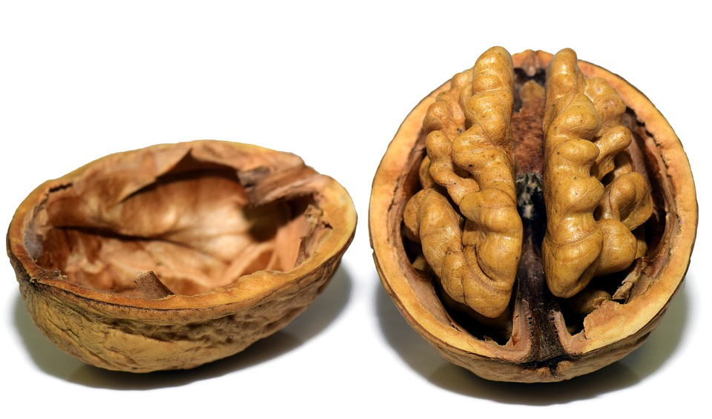
AB 705 English & Reading implementation in a nutshell
We will assess students by high school GPA and upcoming Guided Self Placement if students do not have a HS GPA
No more required pre-requisite classes: EWRT & READ 200 / 211
Students with GPA of 2.6 and above place directly into EWRT 1A
Students with GPA of 1.91 to 2.59 place into EWRT 1A + co-requisite
Students with GPA of 0 - 1.9 place into :Stretch” EWRT 1AS (first quarter) and EWRT 1AT (second quarter)

Slide 16
https://www.chronicle.com/interactives/Trend19-Remediation-Main
“The End of the Remediation Course” by Katherine Mangan The Chronicle of Higher Education, Feb. 19, 2019

