Slide 1
District Opening Day, Fall 2023
Making it Meaningful: Preparing for Program Review – Mission, Goals and Learning Outcomes Mary Pape, Veronica Avilla, Mallory Newell
Notes:
Veronica
2 minutes

Slide 2
Outcomes and Objectives
Objective for Today’s Workshop
Attendees will be prepared to respond to three key prompts in the comprehensive program review form: mission, goals and learning outcomes dialogue and improvements.
Outcomes
Locate, reflect and revise your area’s mission statement.
Draft goals for your area that align to its mission and learning outcomes.
Develop a better understanding of the importance of dialogue around learning outcomes to improve outcomes.
Obtain information pertaining to the new comprehensive program review process.
Notes:
Veronica
2 minutes

Slide 3
The Deeper Purpose Behind Program Review and Student Learning Outcomes
Notes:
Mallory

Slide 4
Why Program Review?
What program review is:
A headache
Last minute effort to complete
Completed by the department chair alone
A waste of time
Not used for anything
What program review should be:
Thoughtful
Collaborative
Reflective
Forward looking
A tool for program improvement
A tool for resource allocation decisions
Notes:
Mallory
2 minutes

Slide 5
Purpose of Program Review
Accreditations Standard I.B.1: The institution demonstrates a sustained, substantive and collegial dialog about student outcomes, student equity, academic quality, institutional effectiveness, and continuous improvement of student learning and achievement.
Accreditations Standard I.B.7: The institution regularly evaluates its policies and practices across all areas of the institution, including instructional programs, student and learning support services, resource management, and governance processes to assure their effectiveness in supporting academic quality and accomplishment of mission.
Notes:
Mallory
2 minutes

Slide 6
Purpose of SLOs
Accreditation Standard I.B.2: The institution defines and assesses student learning outcomes for all instructional programs and student and learning support programs.
Accreditation Standard I.B.6: The institution disaggregates and analyzes learning outcomes and achievement for subpopulations of students. When the institution identifies performance gaps, it implements strategies, which may include allocation of human, fiscal and other resources, to mitigate those gaps and evaluates the efficacy of those strategies.
Notes:
Veronica
2 minutes

Slide 7
Purpose of Goals
Goals are the targets, aspirations, or milestones set to guide achievement of course, program or institutional outcomes.
Goals should be aligned with your area mission and help it achieve its learning outcomes.
Goals should lead to a prioritization of resources to be requested through the program review process.
All areas will be asked to set a goal, devise a strategy to reach the goal and annually evaluate its progress through the annual program review reflection in years 2 and 3.
Notes:
Mary
emphasize as goals are part of the new accreditation Standards
2 minutes

Slide 8
Freewrite #1
Think about the skills, knowledge, abilities, services, or support your area provides to the campus.
Write down 10 words in Box 1.
Notes:
Mallory
5 minutes

Slide 9
Mission Review
As we review the college’s vision, mission and values, take note of the words that jump out to you and write them in Box 2.
Notes:
Mallory
1 minute

Slide 10
Vision
Our Vision
Empower all students to attain their educational goals, develop an equity-based mindset and become civic leaders in their communities.
Notes:
Mary
1 minute

Slide 11
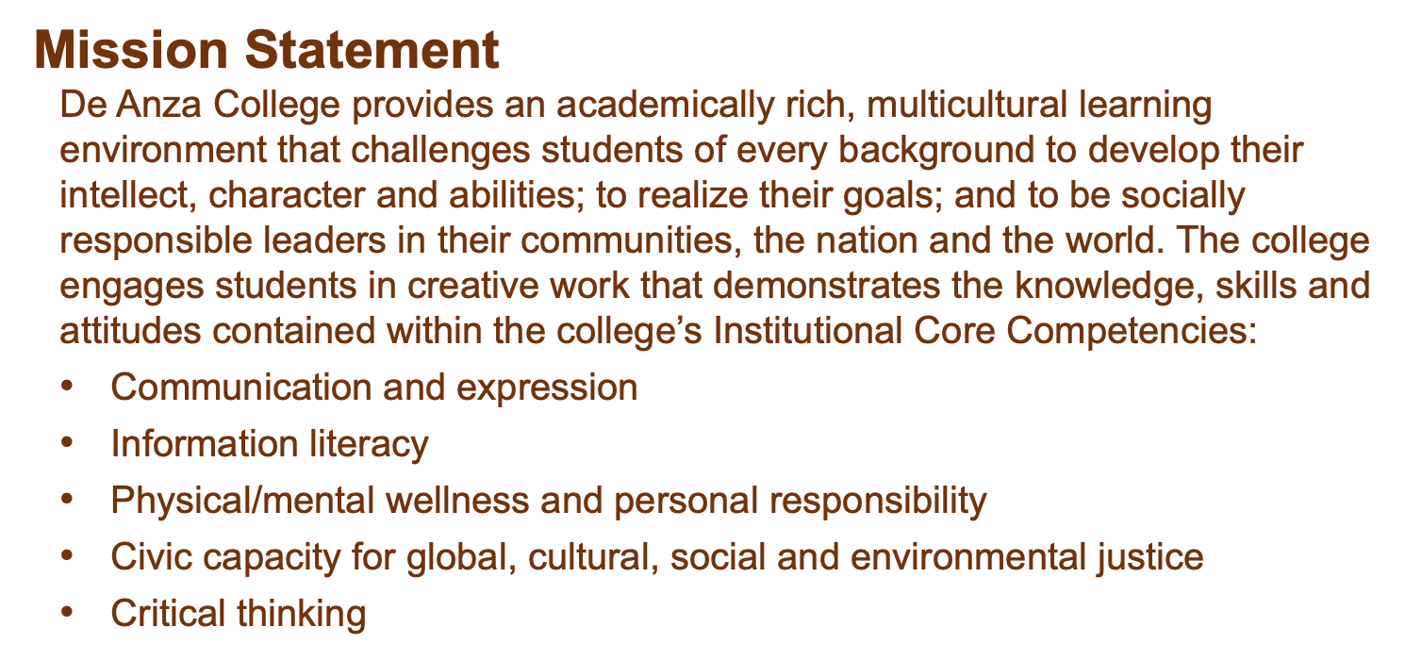
Mission
Notes:
Mary
2 minutes

Slide 12
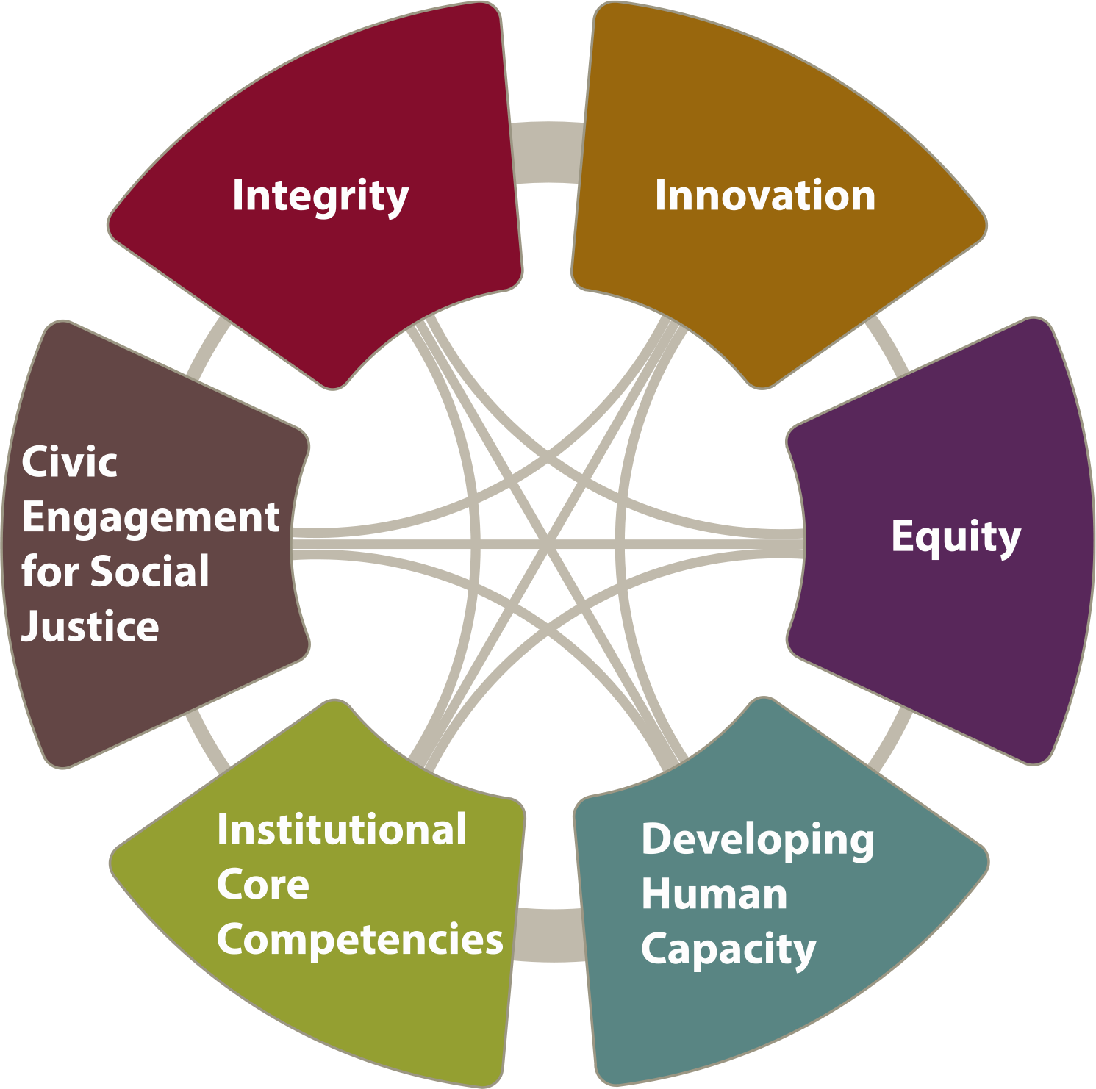
Values
Notes:
Mary
1 minute

Slide 13
Student Success Factors
We will provide support in six key factors of student success. Our students will be:
Directed, with a goal and the knowledge of how to achieve it.
Focused, staying on track to achieve that goal.
Nurtured, feeling that we want to, and do, help them to succeed.
Engaged, actively participating in class and extracurricular activities.
Connected, feeling that they are part of the college community.
Valued, with their skills, talents and abilities recognized, and with opportunities to contribute on campus and feel that their contributions are appreciated.
Notes:
Mary
2 minutes

Slide 14
Pair Share
What words jumped out to you?
Notes:
5 minutes - Mary

Slide 15
Mission Statements
Notes:
Mallory

Slide 16
Crafting a Meaningful Mission
A mission statement is at the core or your area and defines its purpose.
A clear mission statement should capture the essence of the area. It should:
Define its purpose
Outline its primary objectives
Clearly state why it exists
Invoke enthusiasm and excitement for your area
A mission statement should guide the actions of your area and include a focus on your learning outcomes.
A well-crafted mission provides the framework in which your area can achieve its goals and learning outcomes.
Notes:
Mallory
2 minutes

Slide 17
Considerations for Crafting a Mission
The statement should be in the present tense.
It should be short, clear and powerful.
It should use simple and concise terminology.
It should speak loudly and clearly.
Notes:
Mallory
2 minutes

Slide 18
Mission Review
Let’s review a few mission statements for different areas across campus.
What words are similar across the area’s mission and the college mission?
What about the mission statement gets you excited?
Notes:
Mallory
2 minutes

Slide 19
Mission Review
The mission of our lower division classes is to develop students' sociological imagination and deepen their awareness and understanding of the social world.
Art classes serve to nurture student creativity and deepen students’ understanding of the ways art shapes society, and to cultivate enhanced visual literacy for participation in a technologically complex world.
The mission of the Financial Aid Office at De Anza College is to provide financial aid assistance and eligibility awareness to students as they pursue their educational goals. The Financial Aid Office provides the opportunity for all current and prospective community college students’ access to financial aid resources.
Office of Campus Life provides opportunities for students to develop their leadership capacity and prepare them to be responsible and engaged citizens of the world.
Notes:
Mallory
Ask them to read one from the audience
2 minutes

Slide 20
Mission Review
De Anza's Computer Information Systems department has been a leading educational institution in Silicon Valley since the college was founded. Over the years it has developed a rich and diverse series of courses in many areas. Our courses meet the needs of both the transfer student and the industry profession.
To provide students a thorough understanding of the California real estate market from a buyer’s, seller’s and real estate professionals perceptive.
To provide De Anza’s students, faculty, staff and the public with a clean, safe, and sanitary environment for learning and teaching throughout the campus
The mission of the De Anza library is to provide students with the information skills they need to be successful at De Anza as well as in upper division courses, in the job market and as information consumers and creators throughout their lives.
Notes:
Mallory
2 minutes

Slide 21
Your Area’s Mission Statement
Use your device to navigate to your area’s webpage and try to find its mission statement.
Write the mission statement on the paper provided to you in Box 3.
If you cannot find a mission statement for your area, what words would you include in the mission statement of your area if it had one?
Notes:
Mallory
5 minutes

Slide 22
Freewrite #2
Take a moment to reflect on ideas to revise/improve your current mission statement in Box 4:
Considerations when revising/improving your mission statement:
Alignment with the college vision, mission, values and success factors
Clearly describe what your area hopes to achieve
Describe why your program is unique, important or valuable
Invoke enthusiasm and excitement for your area
Notes:
Mallory
10 minutes

Slide 23
Pair Share
What are your thoughts on your area’s mission statement?
Does the current mission include some of the words you wrote down initially in Box 1 and Box 2?
Which words are included, which may be missing?
Notes:
Mallory
5 minutes
50 hour to here

Slide 24
Learning Outcomes
Notes:
Mary

Slide 25
Learning Outcomes vs. Goals
Purpose of Learning Outcomes: To improve the skills, knowledge and ability of those served by your area.
Focused on the student or employees served and their learning progress.
Purpose of Goals: Improving the infrastructure within your area to make the outcomes achievable.
Example SLO: The student will be able to read and analyze intermediate level code.
Example Assessment: Students are given a program to analyze and read at any point in the quarter.
Example Goal: Expand the Python program to include a greater focus on data science skills by adding a course in Data Science.
Example Evaluation of Goal: Within 3 years, the Data Science course is available for students to enroll and is part of a degree.
Notes:
Mary
2 minutes

Slide 26
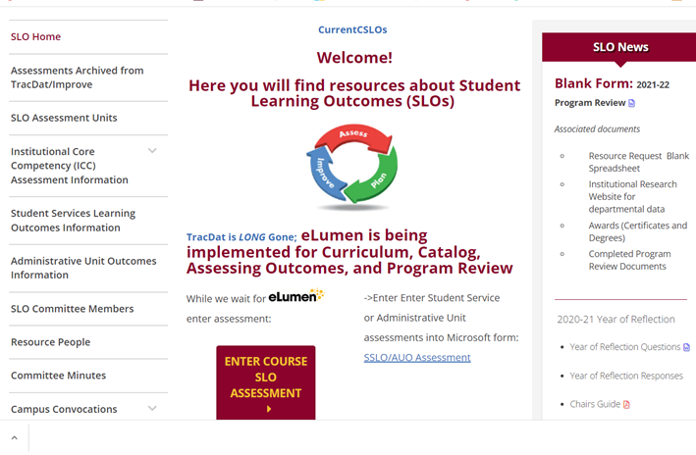
Sharing your assessment insights
Enter your data from Course Student Learning Outcomes (CSLO) assessment
Questions on this Microsoft Form are similar to TracDat but summary is according to what will be on Collective eLumen assessment rubric
Notes:
Mary
2 minutes

Slide 27
What’s on the Form?
Select your Division
Enter the name of your department
Enter the name of the course with section. For example, MATH 22-50Z
Enter CRN# for course
Enter SLO Statement(s) As it (they) appear on the Course Outline of Record. You may assess one or more at a time.
Academic Year
Quarter of Assessment
Modality of class
Method of Assessment
Elaborate on Assessment Method
Notes:
Mary
2 minutes

Slide 28
Pair Share
Using a device, navigate to the SLO page or your course syllabus to find your current learning outcomes for one course in which you teach.
In a pair, share:
How are your learning outcomes aligned (or not) with your area’s mission statement?
Notes:
Mary
Note these questions are in the comprehensive program review form.
10 minutes

Slide 29
What’s on the Form?
11. Number of students exceeding expectations
12. Number of students meeting expectations
13. Number of students approaching expectations
14. Number of students who do not meet this/these outcome(s)
15. N/A Not Applicable (withdrew, absent, ...)
16. Reflection
17. Enhancement/Action
Direct link to form:
https://forms.office.com/pages/responsepage.aspx?id=n7L3RQCxQUyAT7NBighZSmQvhxolAOVOgvRaF3uDNSlUMU9CSURRWEhIOU9ZUEE1R09KRkdVWlpaSC4u
Notes:
Mary
2 minutes

Slide 30
Learning Outcomes Assessment Dialogue
What types of dialogue does your area engage in around its learning outcomes?
Questions to consider:
Do your learning outcomes inform your course curriculum, content and instructional materials?
Do your learning outcomes inform the services you provide, how and when they are provided and in what format?
Do you use the learning outcome process as an opportunity to assess student or employee learning, make changes, implement the changes and reassess?
Does your department use the program review process as a collaborative and intentional opportunity to improve student and employee outcomes?
Notes:
Mary
5 minutes

Slide 31
Goal Setting
Notes:
Veronica

Slide 32
Considerations in Setting Goals
Goals should be SMART:
Specific, try focusing on only one area at a time with a clear outcome.
Measurable and allow you to track progress.
Achievable, identify what you need to do to make it happen.
Realistic, possible to achieve given the current resources.
Time-bound, set a time for achieving the outcome and seeing results
Smarter Goal
Notes:
Veronica
2 minutes

Slide 33
Freewrite #3
In Box 5, draft 1 to 3 goals that you would like your area to explore over the next three years to help it continue to improve and meet its learning outcomes.
Notes:
Veronica
5 minutes

Slide 34
Pair Share
Share one goal you listed.
If you have time, discuss ideas on how you would go about evaluating the achievement of one of the goals.
Notes:
Veronica
10 minutes

Slide 35
Comprehensive Program Review
All programs and areas will engage in a Comprehensive program review in fall 2023
Forms are now available on the RAPP website: https://www.deanza.edu/gov/rapp/program_review.html
Instructional Programs Comprehensive Program Review Form (example)*
Student Services Comprehensive Program Review Form (CAS example)
Academic Services Comprehensive Program Review Form (example)*
Collegwide Service Areas Comprehensive Program Review Form
Notes:
Mallory – demo new tool and promote program review workshop on Friday 2-3 p.m. Hyflex Classroom, MLC
2 minutes

Slide 36
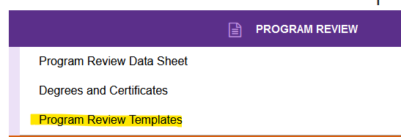
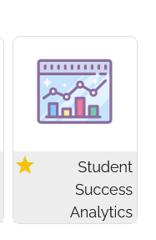
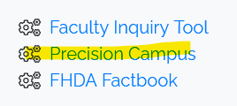
Comprehensive Program Review
Notes:
Mallory – demo new tool and promote program review workshop on Friday 2-3 p.m. Hyflex Classroom, MLC
5 minutes
1:40 if we keep to the timing, gives us time to go over here and there.

